Slide 1

Managing
Conflict
Mary Dixson, PhD
Images by Freepik.com

Slide 2
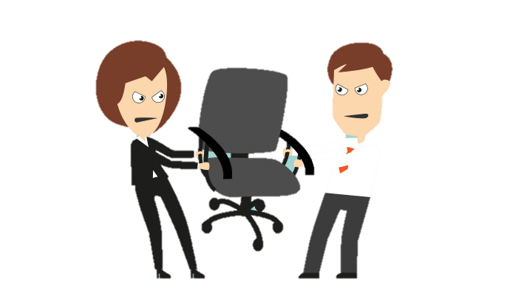
What is Conflict?

Slide 3
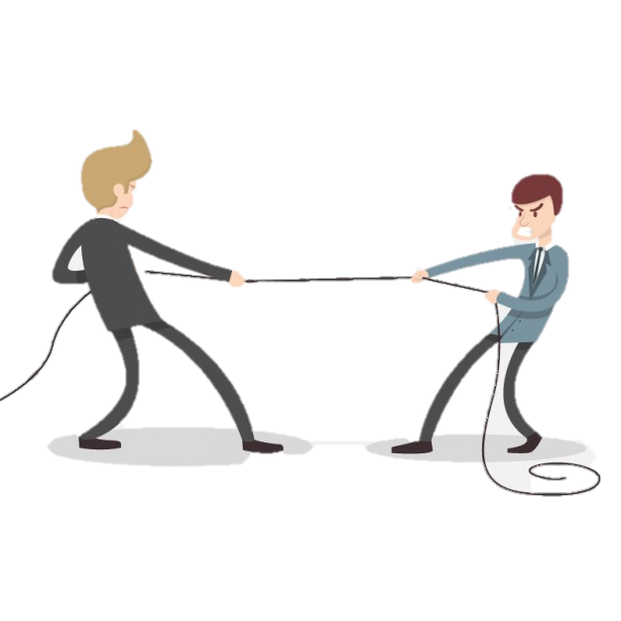
What is conflict?
An expressed struggle between at least two interdependent people who perceive incompatible goals, scarce resources and interference from others to achieve specific goals
Notes:
Interplay: The Process of Interpersonal Communication, 12th Edition. Ronald B. Adler, Lawrence B. Rosenfeld, Russell F. Proctor, II. Chapter 11.

Slide 4
Let’s break that down
expressed struggle
two or more interdependent people
incompatible goals
scarce resources
interference from others
achieve specific goals
Interplay by Adler et al.
Notes:
Interplay: The Process of Interpersonal Communication, 12th Edition. Ronald B. Adler, Lawrence B. Rosenfeld, Russell F. Proctor, II. Chapter 11.

Slide 5
Misconceptions
Conflict must be avoided
Conflict exists because people don’t understand each other
Conflict can always be resolved
People who really like each other don’t have conflicts

Slide 6
Identify causes
Conflicting resources
Conflicting styles
Conflicting perceptions
Conflicting goals
Conflicting pressures
Conflicting roles
Different personal values
Unpredictable policies
Notes:
Art Bell and Brett Hart

Slide 7
Avoid Misunderstandings
Ask others what they mean by their terms or phrases
Establish supportive rather than defensive climate
Become an active listener

Slide 8
Manage Issue Disagreement
Clarify each other’s perception of message
Focus discussion on issues, not personalities
Use facts, not opinions
Tackle one issue at a time
Find areas of agreement

Slide 9

Decide what you REALLY want
Look for common goals
Commit to listen
Explore options
Agree on actions
Crucial Conversations, 2012
Notes:
Crucial Conversations: Tools for Talking When Stakes are High (2012) Joseph Grenny, Al Switzler, Ron McMillan

Slide 10
Managing Personality Clashes
Stay aware of emotion and defensiveness
Encourage active listening
Focus problem to be solved, rather than a conflict to win
Seek a cool, calm climate
Be descriptive rather than judgmental
Agree to disagree and return to areas of agreement

Slide 11
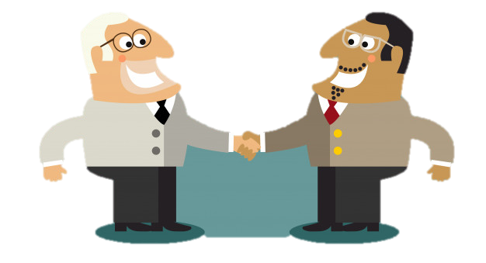
Manage Your Emotions
Be aware of your anger level
Monitor your non-verbal messages
Avoid personal attacks
Describe what is upsetting you
Use “I” statements instead of “you”
Notes:
Crucial Conversations (2012) Joseph Grenny, Al Switzler, Ron McMillan

Slide 12

How should you handle conflict?
Collaborate for a solution
Compromise for a middle ground
Fight to win the conflict
Submit to others to end the conflict
Avoid conflict

