Slide 1

Improving Group Climate
Reducing Conflict by Managing Messaging
Mary Dixson, PhD
Images by Freepik.com

Slide 2
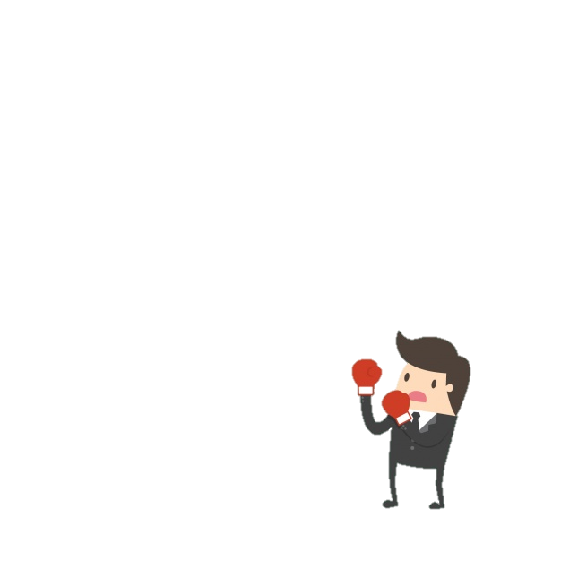
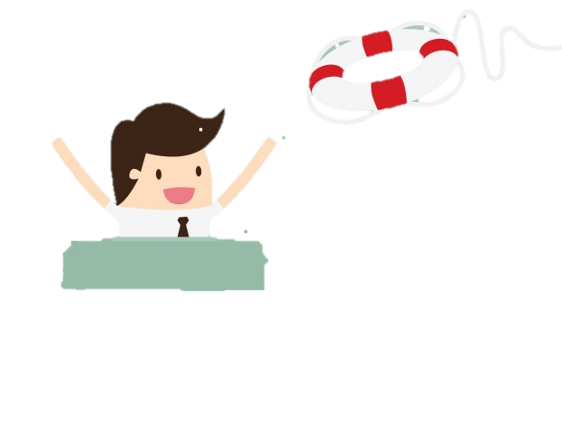
Jack Gibb - 1961
Identified 2 types behaviors the influence group climate
Defensive
Supportive

Slide 3
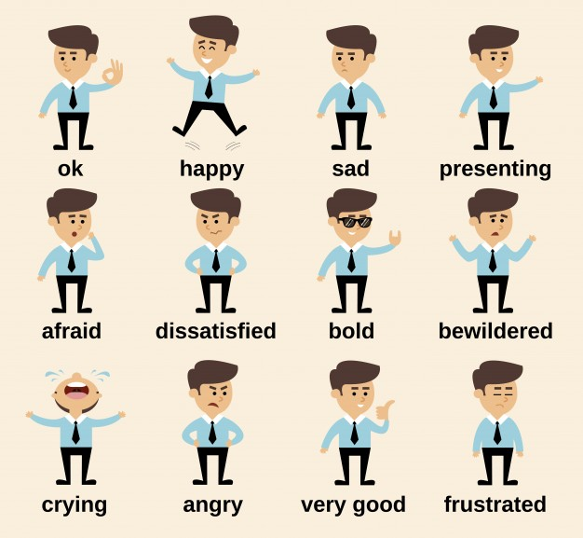
What’s a Climate?
The atmosphere or emotional tone

Slide 4
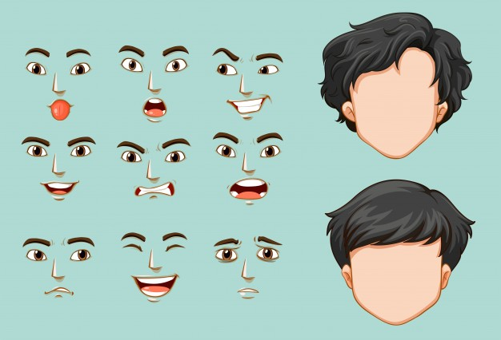
Gibbs thought you could alter the climate
By using defensive and supportive behaviors

Slide 5
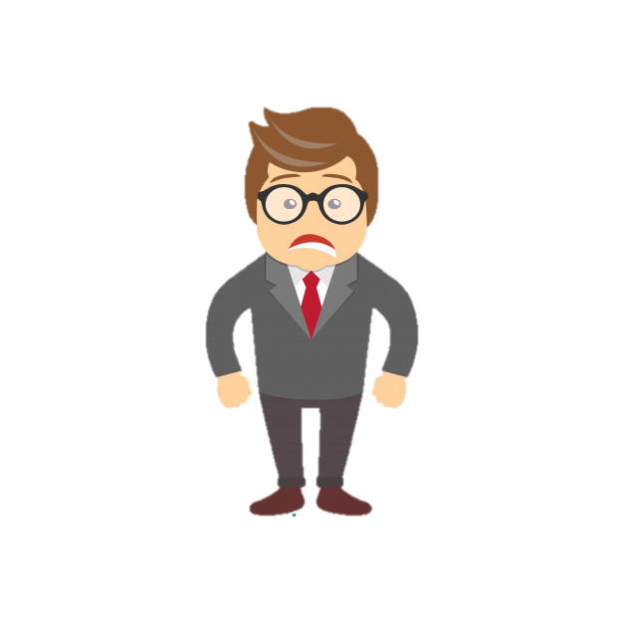
Disconfirming response cause listeners to value themselves less

Slide 6
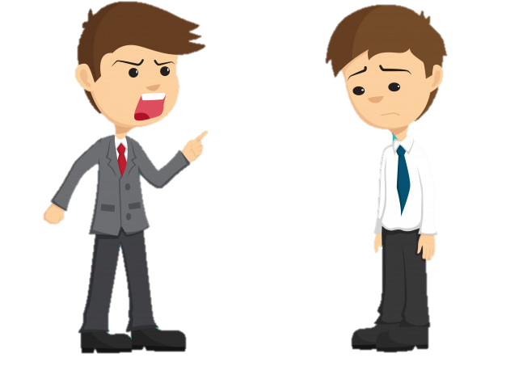
You have a lot more power than you think

Slide 7
Defensive vs. Supportive
Evaluation
Control
Strategy
Neutrality
Superiority
Certainty
Description
Problem Orientation
Spontaneity
Empathy
Equality
Provisionalism

Slide 8
Evaluation
Description
Arouses Defensiveness
Judgmental Statements
“You” language
“You’re always late!”
“You never get things done!”
Focus on the speaker
“I” language
Describe instead of judge
“I feel frustrated if you’re late.”
“I worry when things aren’t done.”

Slide 9
Control
Problem Orientation
Sender imposes a solution
Controlling behavior
“Do not add that paragraph!”
“I will not accept that slide!”
Team attitude
Don’t focus on winning
Find solutions to meet team needs
“Let’s talk about that paragraph.”
“Can we change the slide?”

Slide 10
Strategy
Spontaneity
Ulterior motives
Manipulation
Deception
“I hear team 2 only meets
for 10 minutes.”
Say what you mean (nicely)
Don’t try to manipulate
“I think our meetings run
longer than we need.
Can we talk about it? “

Slide 11
Strategy
Spontaneity
Ulterior motives
Manipulation
Deception
“I hear team 2 only meets
for 10 minutes.”
Say what you mean (nicely)
Don’t try to manipulate
“I think our meetings run
longer than we need.
Can we talk about it? “

Slide 12
Neutrality
Empathy
Indifference
Disconfirming
Lack of concern for others
“You have the flu? I hope you can get your section done.”
Put yourself in someone’s place
Express emotion
Confirm what’s happening
“I’m so sorry you don’t feel well. That can be stressful
at this time of year. “

Slide 13
Superiority
Equality
I’m better than you
Expression of contempt
“I’ve already told you
how to do it the right way.”
Create parity
Focus on your improvement
“I struggle with this, too.
Do you want me to show
you how I do it? “

Slide 14
Certainty
Provisionalism
My opinion is right
I know everything
“That will never work.”
Listen to opinions
Willing to change your mind
“I hadn’t heard that before!”
“I’d like to hear what you think.”

Slide 15
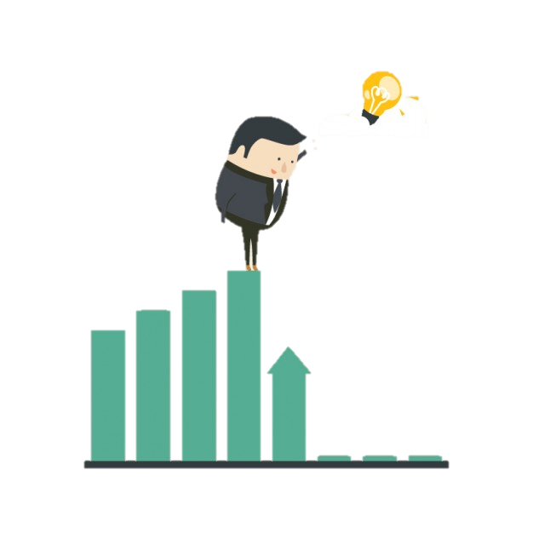
How to improve
Be aware of your own behavior
Catch yourself if you use a disconfirming behavior
Don’t react to other’s defensive behavior
Practice in various situations

Slide 16

You may tend to be defensive…
But you can change…

