Slide 1

Painless Presentations:
Overcoming the pitfalls of public speaking
Fear of Public Speaking

Slide 2

Anxiety
Managing and using your emotions
Notes:
No matter what your topic, you are there for a reason. You have to adopt an attitude that your content matters.

Slide 3
1
What Scares Us

Slide 4
Speech Anxiety
Feelings of discomfort felt before during or after speaking in public
It’s normal
It’s natural
It’s manageable

Slide 5
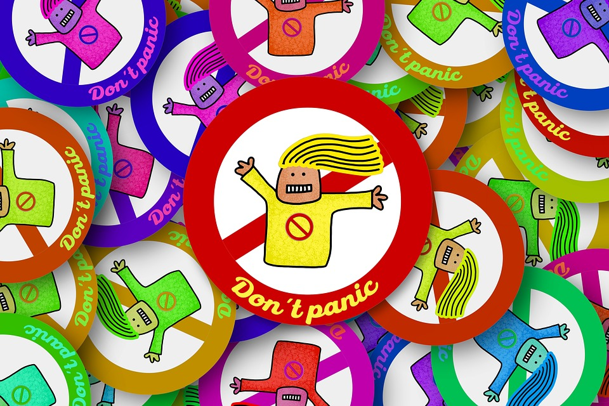
Fear is natural
Fear of attention
Fear of failure
Fear of being ridiculous

Slide 6
Why does it matter?
People who experience high levels of anxiety:
struggle to complete speaking assignments
avoid classes in which speaking is required
miss out on learning an important life-skill
suffer unnecessarily

Slide 7
It’s self inflicted
Self criticizing (“I’m a terrible speaker”)
Avoid preparing and practicing (avoiding the speech)
Self-pressure (“I have to be perfect”)
Catastrophizing statements (imagine worst case scenario)

Slide 8
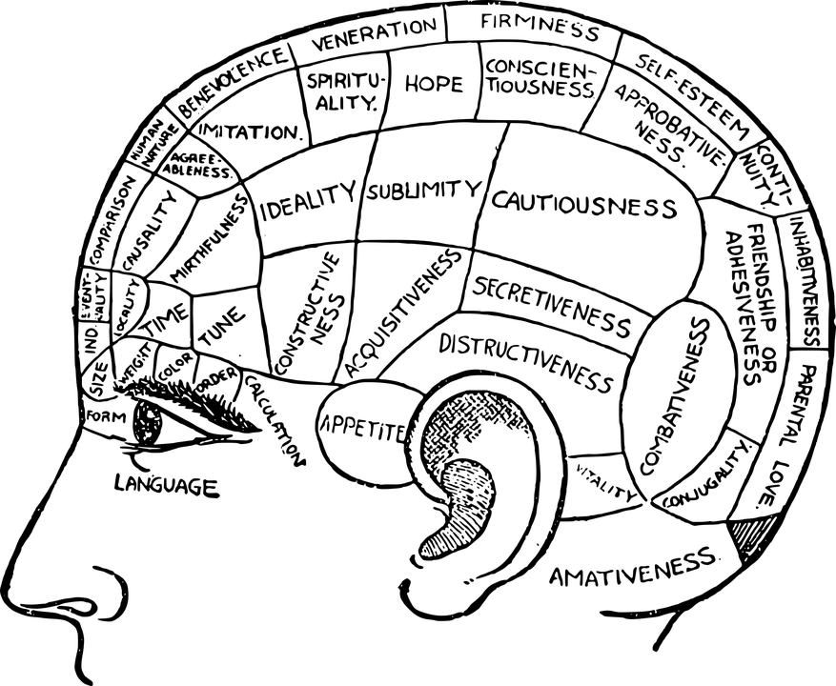
2
Physical Effects
Notes:
If you aren’t there yet, then ask two questions: So what? And who cares? What is the audience going to get from me presentations. Why does it matter and to who? If you can’t answer these two questions, you shouldn’t be speaking.

Slide 9
From your brain to your body
What starts as your brain’s response to fear
Becomes a physical reaction
Notes:
If you aren’t there yet, then ask two questions: So what? And who cares? What is the audience going to get from me presentations. Why does it matter and to who? If you can’t answer these two questions, you shouldn’t be speaking.

Slide 10
Fight of Flight Response
Heart rate increases
Blood vessels constrict
Chills and sweating
Dry mouth
Stomach aches
Tense & shaking muscles
Chills and sweating
Quick breathing
Notes:
If you aren’t there yet, then ask two questions: So what? And who cares? What is the audience going to get from me presentations. Why does it matter and to who? If you can’t answer these two questions, you shouldn’t be speaking.

Slide 11
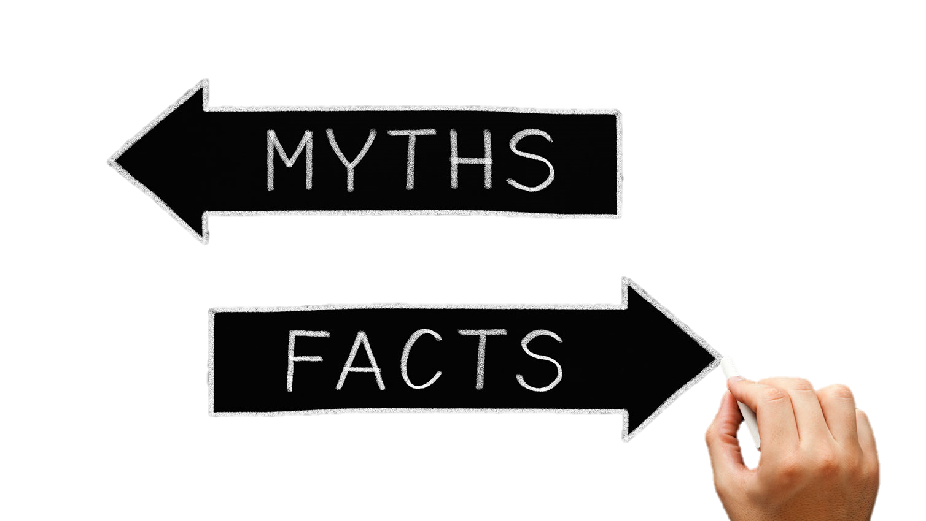
3
Myths about anxiety

Slide 12
Myth 2: There’s something wrong with me
Speech Anxiety is a normal reaction to public speaking
It is experienced by 3/4 of the population
Notes:
If you aren’t there yet, then ask two questions: So what? And who cares? What is the audience going to get from me presentations. Why does it matter and to who? If you can’t answer these two questions, you shouldn’t be speaking.

Slide 13
Myth 2:
Say the words out loud
Practice standing up
Practice in front of a mirror, a friend, or even a wall
Try filming it and watching it bag
Notes:
If you aren’t there yet, then ask two questions: So what? And who cares? What is the audience going to get from me presentations. Why does it matter and to who? If you can’t answer these two questions, you shouldn’t be speaking.

Slide 14
Myth 3: Memorizing helps reduce anxiety
Memorizing a speech is more likely to cause anxiety
Instead, remember your thesis and your main points
Delivery tends to sound more canned
Notes:
If you aren’t there yet, then ask two questions: So what? And who cares? What is the audience going to get from me presentations. Why does it matter and to who? If you can’t answer these two questions, you shouldn’t be speaking.

Slide 15
Myth 4: Mistakes are disastrous
Most mistakes go unnoticed
Mistakes can humanize your presentation and make you more approachable to your audience
Notes:
If you aren’t there yet, then ask two questions: So what? And who cares? What is the audience going to get from me presentations. Why does it matter and to who? If you can’t answer these two questions, you shouldn’t be speaking.

Slide 16
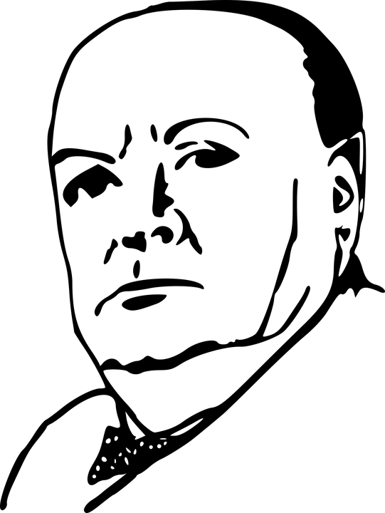
Myth 5: Great speakers don’t get nervous
Most speakers get nervous before speeches.
Winston Churchill reported being physically ill prior to speaking before Parliament.
Notes:
If you aren’t there yet, then ask two questions: So what? And who cares? What is the audience going to get from me presentations. Why does it matter and to who? If you can’t answer these two questions, you shouldn’t be speaking.

Slide 17


Journalist Edward R. Murrow said
"The best speakers know enough to be scared... the only difference between the pros and the novices is that the pros have trained the butterflies to fly in formation."
Notes:
If you aren’t there yet, then ask two questions: So what? And who cares? What is the audience going to get from me presentations. Why does it matter and to who? If you can’t answer these two questions, you shouldn’t be speaking.

Slide 18
Training the Butterflies
Practice relaxation exercises (deep breathing)
Practice your speech
Know your topic and find it interesting
Use positive self-talk
Visualize success
Thank of the audience as on your side
Chanel nervous energy into your presenation

Slide 19
Remember:
Only one person is known to have died from public speaking.
President William Henry Harrison,
but really it was from the pneumonia he suffered after giving the longest inaugural address in U.S. History.

